Slide 1
Open3D
3DVSS 2023
Kajal Sanklecha

Slide 2
Visualization
Visualization of the loaded mesh / point cloud from any format using Trimesh
Loading using Open3D
Rendering using Trimesh

Slide 3
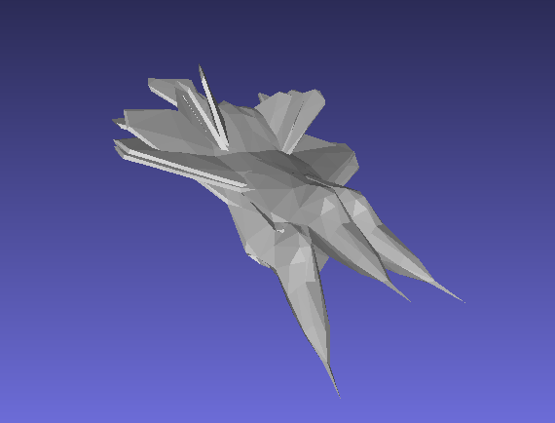
Transformation

Slide 4
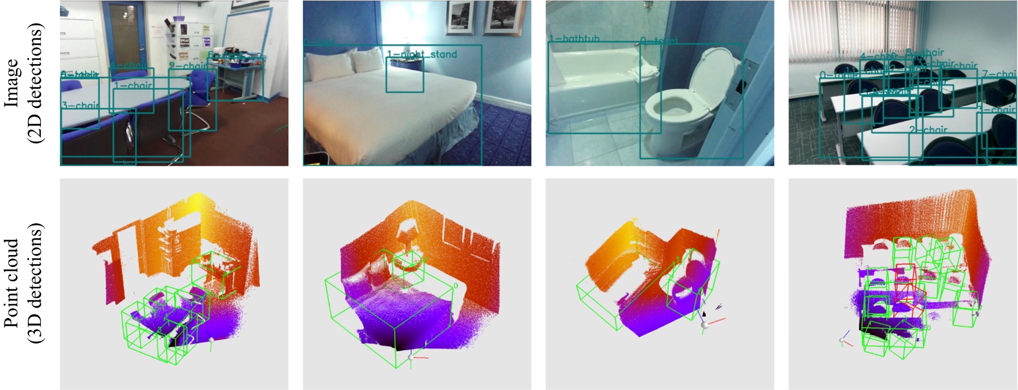
Handling RGBD Data (2.5D)

Slide 5
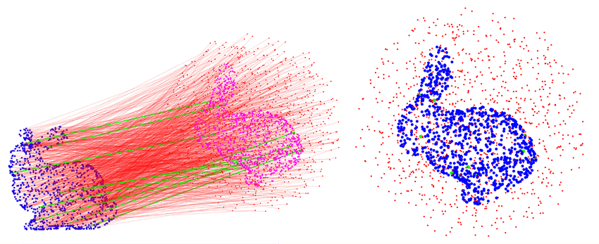
Point Cloud Registration

Slide 6
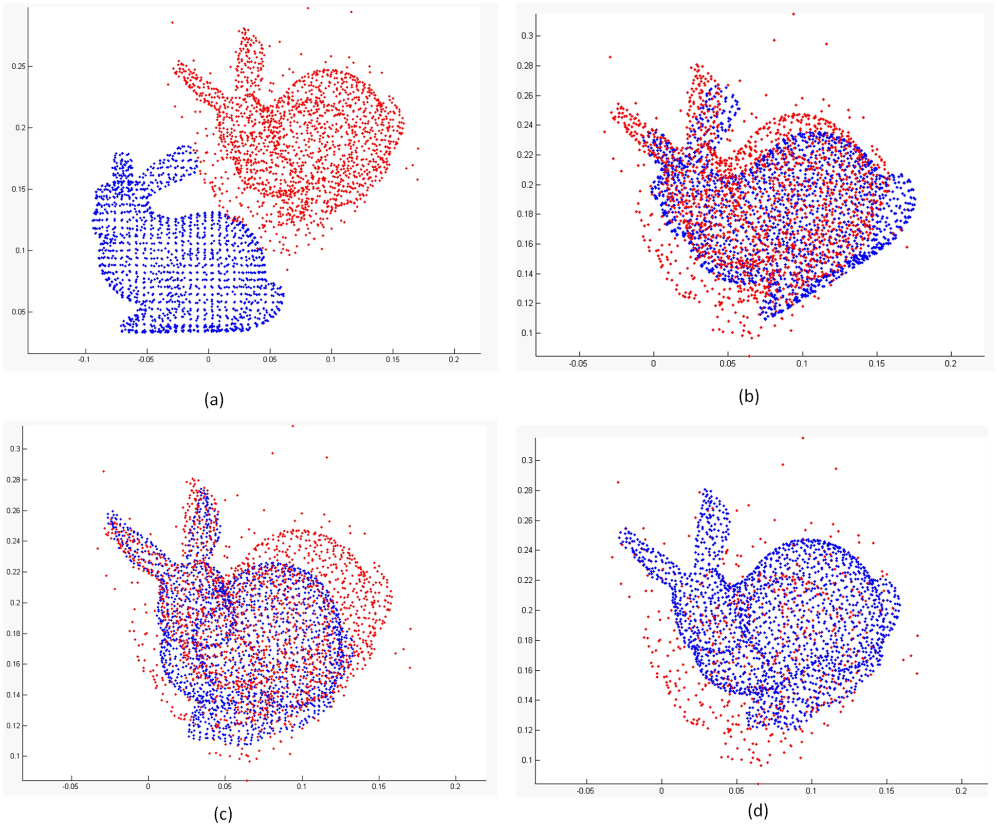
ICP (Iterative Closest Point)

Slide 7
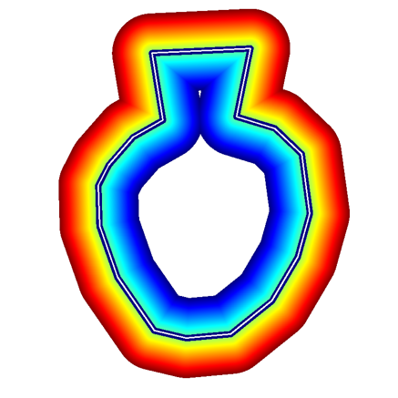
Signed Distance Function (SDF)
Most widely used implicit 3D representation
Negative values on the inside
Zero on the surface
Positive values on the outside

Slide 8
TSDF - Truncated SDF
Truncated Signed Distance Field
Dense volumetric scene reconstruction
Integrates depth readings into the Voxel Block Grid
Reduces noise and generates smooth surfaces

Slide 9
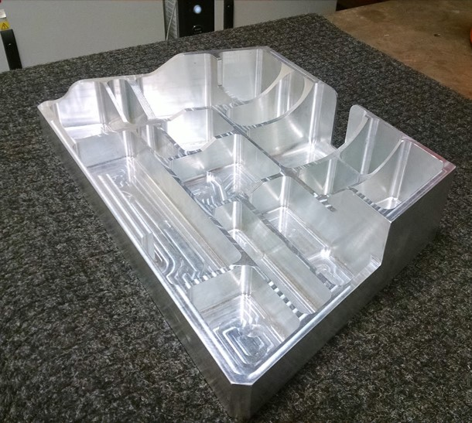
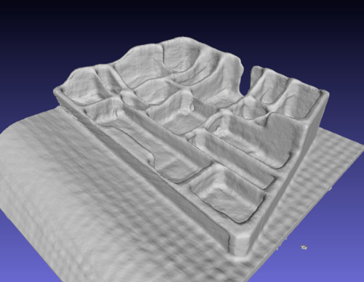
TSDF integration

Slide 10
Any Questions?

